Slide 1
Deep Psychological Adaptation for 2022
By Nic Morrey
TPIG presentation 28th September 2021
for the Australian Psychological Society

Slide 2
Brief overview of Integral
Quadrants (inner/outer & singular/plural)
Levels (of development)
Lines (of intelligence – defence line and moral line)
States (for another session)
Types (for another session)

Slide 3
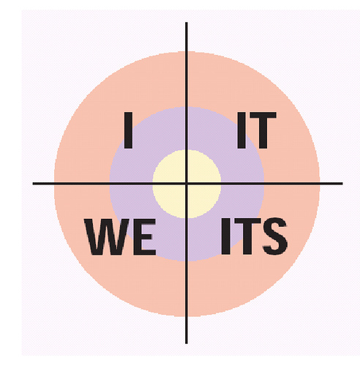
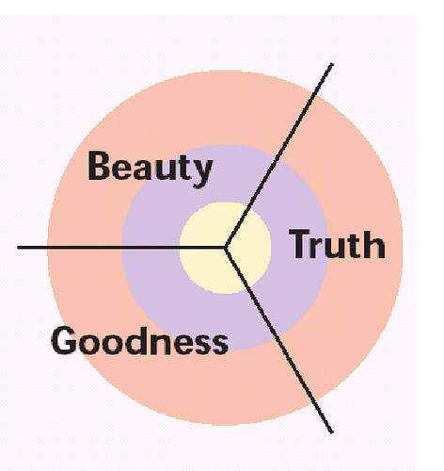
QUADRANTS: The good, the true and the beautiful
Notes:
Good true and beautiful, Plato
the Good, the True, and the Beautiful are dimensions of our very own being at each and every level of growth and development. The promise of this AQAL integral transformative practice, we can discover deeper and deeper dimensions of our own Goodness, our own Truth, and our own Beauty.
The Good, the True, and the Beautiful are
simply variations on first-, second-, and third-person pronouns found in all major
languages, and they are found in all major languages because Truth, Goodness,
and Beauty are very real dimensions of reality to which language has adapted.
Third-person (or “it”) refers to objective truth, which is best investigated by
science. Second-person (or “you/we”) refers to Goodness, or the ways that we—
that you and I—treat each other, and whether we do so with decency, honesty,
and respect. In other words, basic morality. And first-person deals with the “I,”
with self and self-expression, art and aesthetics, and the beauty that is in the eye
(or the “I”) of the beholder.
Steiner , the first 7 years we must keep the child protected from the world so they have a base of what is good, true and beautiful

Slide 4
Notes:
We are not dealing with the whole person if we do not pay attention to the 4 quadrants

Slide 8
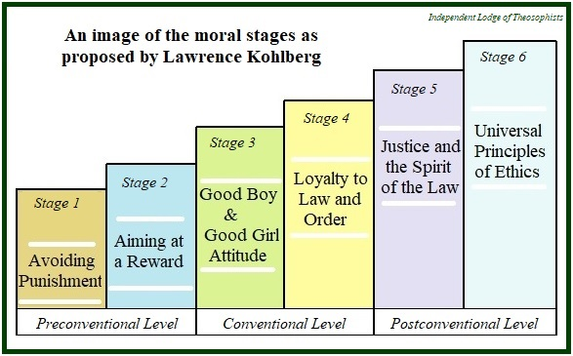

Slide 9
LEVELS: Developmental Falcrums 1 to 10 and matched types of pathology
1. Sensorimotor (psychoses, most adult schizophrenia)
2. Phantasmic-emotional (narcisstic-borderline disorders)
3. Representational mind (borderline neuroses, psychoneuroses)
4. Rule/role mind (script pathology and neuroses)
5. Formal-reflexive (identity neuroses)
6. Vision-logic (centauric, existential pathology: depression, inauthenticity, isolation, aborted self-actualization, and anxiety)
7. Psychic (psychic disorders: inflation, dark night of the soul, split life goals, pseudo-duhkha, pranic disorders, yogic illness)
8. Subtle (subtle pathology: integration-identification failure, pseudo-nirvana, pseudo-realization)
9. Causal (causal pathology: failure of complete self-differentiation, failure to fully integrate with physical forms, also known as Arhat's disease)
10. Ultimate (not really a level, but the suchness, Ground, radical emptiness of all levels).
Notes:
Level of Consciousness
Which ever level of development a client is at, requires a specific level of therapy
Equally,
Which ever level of development a therapist is at, will only be able to ‘hear a client’ from that level
Hence the reason for professional development within the transpersonal realm.
Shiva complex…attaching to bliss states and not moving through them.

Slide 10
LINES: Developmental lines, life’s questions and researchers
Notes:
Lines of Intelligence
These multiple intelligences give us the answers to life’s questions.
As abraham maslow said. “If the only tool you have is a hammer then everything will start looking like a nail”

Slide 11
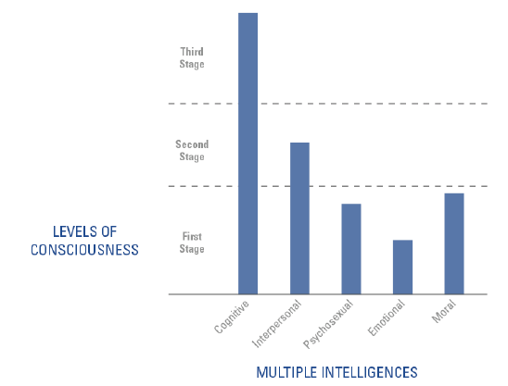
Notes:
Lines of Intelligence
The psychograph
Multiple intelligences Gardner
All developmental lines are interlinked and need to be developed equally to become a well rounded and fully functioning individual. A great tool in therapy
• the spiritual line (what if “spirit” is viewed not just as Ground, and not just as
the highest stage as suggested in transpersonal psychology, but as its own line of unfolding)
the cognitive line (or awareness of what is)
• the moral line (awareness of what should be)
• emotional or affective line (the spectrum of emotions)
• the interpersonal line (how I socially relate to others)
• the needs line (such as Maslow’s needs hierarchy)
• the self-identity line (or “who am I?,” such as Loevinger’s ego development)
• the aesthetic line (or the line of self-expression, beauty, art, and felt meaning)
• the psychosexual line, which in its broadest sense means the entire
spectrum of Eros (gross to subtle to causal)
• the values line (or what a person considers most important, a line studied by
Clare Graves and made popular by Spiral Dynamics)

Slide 12
Spectrum of human development, pathology, defences and treatment

Slide 13
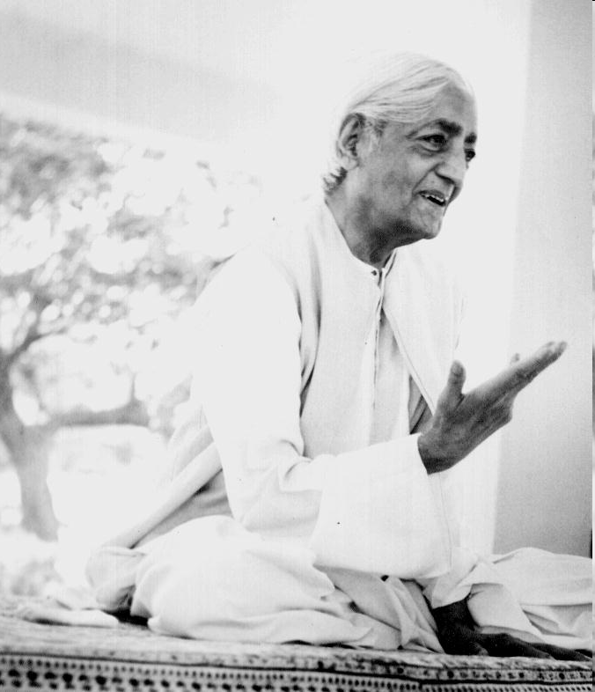
From pre- to modern to post-modern society
“It is no measure of health to be adjusted to a profanely sick society”

